Slide 1
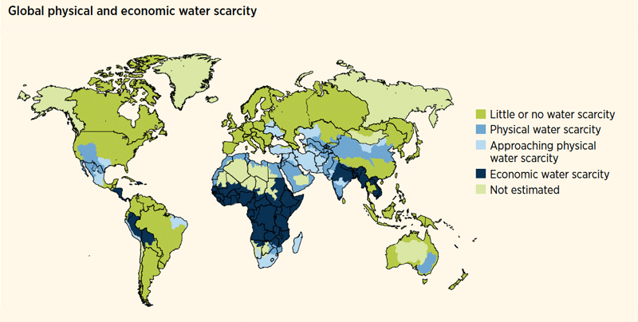
Which parts of the world are most effected by water scarcity?
Create a cause and effect diagram illustrating the possible consequences.
Has your family or anyone you know been effected by water scarcity? Please explain.

Slide 2
Did You Know . . . .
Around 700 million people in 43 countries suffer today from water scarcity.
By 2025, 1.8 billion people will be living in countries or regions with absolute water scarcity, and two-thirds of the world's population could be living under water stressed conditions.
With the existing climate change scenario, almost half the world's population will be living in areas of high water stress by 2030, including between 75 million and 250 million people in Africa.
In addition, water scarcity in some arid and semi-arid places will displace between 24 million and 700 million people.
Sub-Saharan Africa has the largest number of water-stressed countries of any region.

Slide 3
Chapter 1 Section 1: Scarcity, the Basic economic Problem
Objective: 1) Learn three economic questions that societies face because of scarcity 2) describe the four factors of production and their uses

Slide 4
Concept 1: What is Scarcity?
Terms:
Wants: a desire that can be satisfied by consuming a good or purchase
Need: a necessity for a material good
Economics: a social science that focuses on how people choose scarce resources to satisfy wants

Slide 5
Principles of Economics
Principle #1: People’s wants are unlimited and always changing.
Principle #2: Scarcity affects everyone. Consumers (a person who buys goods or services for personal use) are constantly making choices regarding what goods or services they want which effects what producers will make

Slide 6
Concept #2 Scarcity leads to three economic questions
1. What to produce and how much?
2. How will goods/services be produced or offered?
3. For whom and how much?

Slide 7
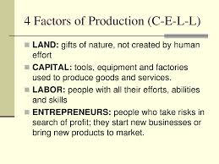
Concept #3 The factors of Production
Think of a product that you recently purchased. How do your think the four factors of production were used to create this product?

